Slide 1

Part 2 Syphilis Testing: Selection and Interpretation
Marguerite A. Urban, MD
University of Rochester Infectious Diseases
Monroe County STD Clinic

Slide 2
Disclosure
I have no conflicts to declare

Slide 3
Objectives
Identify the currently available diagnostic tests for syphilis
Understand the differences between the traditional syphilis testing algorithm and the newer reverse syphilis testing algorithm
Understand the need for follow up syphilis tests after treatment
Describe the role of health departments in maintaining serology registries

Slide 4
Syphilis – Quick Review
Old and complex disease – “to know syphilis is to know medicine”
Classified in stages – based on serology results plus presence or absence of signs and symptoms
  Can affect virtually every organ with a myriad of clinical manifestations – “the great imitator”
  May have long periods of latency
  Relatively easily treated
Infectious Syphilis – early stages (primary, secondary, early latent)

Slide 5
Syphilis – Quick Review
Caused by spirochete: Treponema pallidum
Divided into clinical stages:
  Primary - chancre
  Secondary - rash, adenopathy, and more
  Latent – no signs/symptoms
    Early latent – present for less than 1 year
    Late latent – present for more than 1 year
  Tertiary – CNS, cardiovascular, gumma

Slide 6
Primary and Secondary Syphilis Cases in NY
1960 -2012
From NYS DOH, Bureau of STD Prevention and Epidemiology,
Statistical Abstracts

Slide 7
Early Syphilis Cases (rates) Upstate by Region, 2000-2011
(Source: http://www.health.ny.gov/statistics/diseases/communicable/std/)
 | Albany area | Buffalo area | Rochester area | Syracuse | Metro NY | NYC
2000 | 1 (.07) | 2 (.08) | 1 (.08) | 8 (0.46) | 23 (.47) | 564(7.04)
2003 | 7(0.5) | 5 (0.3) | 15 (1.2) | 13(0.8) | 74 (1.5) | 1482 (18.5)
2005 | 21(1.4) | 13 (0.8) | 20 (1.6) | 13 (0.8) | 126(2.6) | 1596 (19.9)
2007 | 30 (2.1) | 18(1.1) | 24(1.9) | 20(1.2) | 375(7.6) | 2282(28.5)
2009 | 28 (1.9) | 16(1.0) | 23(1.8) | 12 (0.7) | 183 (3.7) | 2190 (27.3)
2011* | 60 (4.0) | 24 (1.5) | 30 (2.3) | 28 (1.6) | 209 (4.2) | 1998 (24.9)
Albany - Albany, Clinton, Columbia, Delaware, Essex, Franklin, Fulton, Greene, Hamilton, Montgomery, Otsego, Rensselaer, Saratoga, Schenectady, Schoharie, Warren, Washington
Buffalo - Allegany, Cattaraugus, Chautauqua, Erie, Genesee, Niagara, Orleans, Wyoming
Rochester - Chemung, Livingston, Monroe, Ontario, Schuyler, Seneca, Steuben, Wayne, Yates
Syracuse - Broome, Cayuga, Chenango, Cortland, Herkimer, Jefferson, Lewis, Madison, Oneida, Onondaga, Oswego, St. Lawrence, Tioga, Tompkins
Metro NY - Dutchess, Nassau, Orange, Putnam, Rockland, Suffolk, Sullivan, Ulster, Westchester

Slide 8
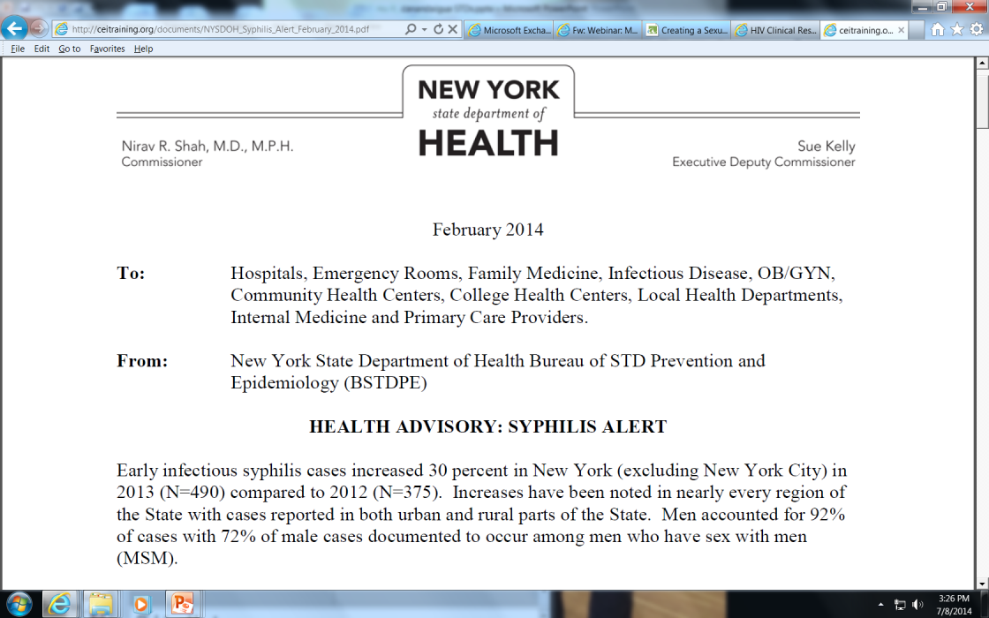

Slide 9
Primary and Secondary Syphilis—Reported Cases* by Stage, Sex, and Sexual Behavior,
United States, 2011
*Of the reported male cases of primary and secondary syphilis, 17.0% were missing sex of sex partner information.
†MSM=men who have sex with men; MSW=men who have sex with women only.
2011-Fig 46. SR

Slide 10
Primary and Secondary Syphilis and HIV—Proportion of MSM* Attending STD Clinics with Primary and Secondary Syphilis who are Co-infected with HIV, STD Surveillance Network (SSuN), 2011
*MSM=men who have sex with men.
NOTE: Includes sites that reported data on at least 25 MSM with primary and secondary syphilis in 2011.
2011-Fig X. SR

Slide 11
The Diagnosis of Infectious Diseases
Recognize characteristic Clinical Syndrome associated with particular infectious agents and hopefully confirm through some microbiology
Identify organism
  Visualize organism (microscopy, gram stain, other stains, EM)
  Culture
  Detection of organism through other microbiologic techniques
    Immune assays, NAATs (PCR)
Identify immune response to organism
    Detection of antibody or other immune response (eg. PPD)

Slide 12
Diagnosis of Syphilis
Recognize Clinical Syndrome
  Clinical Diagnosis of Syphilis is generally Poor ( “to know syphilis is to know medicine”)
  Wide spectrum of illness – chancre, rash most often identified
  Long periods of latency
Identify organism – cannot be easily cultured
  Use specimens from lesions to allow visualization of organism
  Available in specialized settings only
Serology (antibody testing) – cornerstone of diagnosis – essential even when making a clinical diagnosis

Slide 13
Syphilis: Lesion based Diagnostic Tests
Identify the organism (not readily available)
    Darkfield examination of lesion exudate
    Direct fluorescent antibody test (DFA) of exudate
    PCR - No FDA licensed amplification tests available in US but some commercial labs offer a PCR test
    Biopsy for histopathology

Slide 14
Lesion Based Diagnostic Tests: Darkfield Microscopy
Obtain sample from moist mucosal lesion: chancre, condylomata latum lesion
Advantages:
Immediate result
Definite diagnosis if positive
Good test performance
  Sensitivity – 75%-85%
  Specificity – 95%
  Disadvantages:
  Need specialized equipment and experienced microscopist
  Should not be used for oral lesions
    Normal flora treponemes found in mouth
  Sensitivity declines with healing of lesion and use of soaps/other topical agents

Slide 15
Lesion Based Diagnostic Tests:
Direct Flourescent Antibody (DFA-TP)
Utilizes a specific antibody for T. pallidum. Sample obtained from moist lesion (chancre, condylomata lata, mucus patch) and sent to laboratory.
Advantages:
Definite diagnosis if positive
Can be used with oral lesions
Not dependent on motility of organism
Disadvantages:
Turn around time 1-2 days so patient must return for results
Not widely available
Sensitivity declines with healing of lesion and/or use of soaps or other topical agents

Slide 16
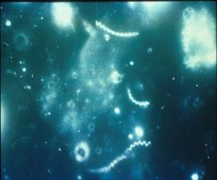
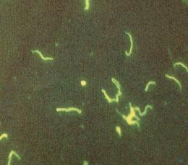
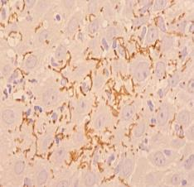
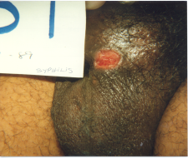
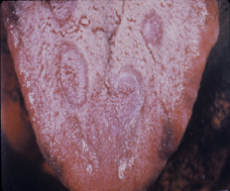
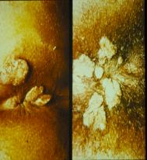
Treponema pallidum
Darkfield microscopy DFA microscopy Histopathology

Slide 17
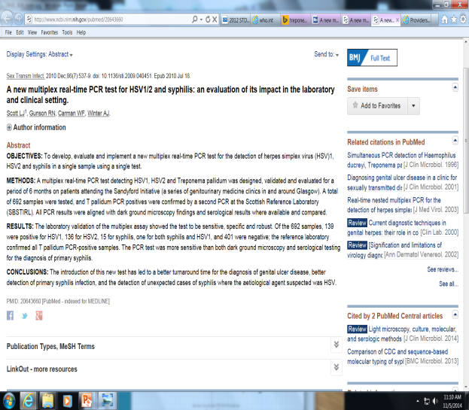
Lesion Based Diagnostic Tests: PCR
No FDA approved PCR for T. pallidum
Some companies offer PCR tests after going through CLIA verification
Several research multiplex PCRs in literature (looks for HSV, H ducreyi, T pallidum)

Slide 18
Serological Tests for Syphilis
(cornerstone of diagnosis)
Two types of serological tests:
  Non-specific, non-treponemal antibody (e.g. RPR, VDRL, TRUST)
    quantitative result (1:256)
    may be negative when chancre develops
  2. Specific, treponemal antibody (FTA-ABS, MHA-TP, TPPA, EIAs, CLIAs, MBIAs)
    qualitative result only (+ or - )
    does not distinguish past and present infection
    positive earlier than non-specific ab
Need both types of tests to make an accurate diagnosis of syphilis
Test performance characteristics vary by stage and activity of disease

Slide 19
Syphilis Diagnostic Tests: Non-treponemal tests
(e.g. RPR, VDRL, TRUST)
Non-specific antibody - must be confirmed with a specific antibody test
All have relatively equivalent sensitivity and specificity
Positive ~3-4 weeks after exposure so may not be + with early chancre (primary syphilis)
May have prozone phenomenon – needs further dilution
Reported as a reciprocal dilution (e.g. 1:256)
Generally declines with treatment
  Used for follow-up after treatment
  May revert to negative over time, even without treatment

Slide 20
Sensitivity of Serologic Tests for Syphilis
From Larsen et al, Clinical Microbiology Reviews, 1995
PRIMARY
SECONDARY
LATE DISEASE
Weeks from exposure
Years from exposure

Slide 21
Dilutions of Non-specific Tests (RPR/VDRL)
1 : 1024
1 : 512
1 : 256
1 : 128
1 : 64
1 : 32
1 : 16
1 : 8
1 : 4
1 : 2
1 : 1
2 dilution or “4 fold” decline
1 dilution or “2 fold” decline

Slide 22
Syphilis Diagnostic Tests: Treponemal Antibody Tests
(e.g. FTA-ABS, TPPA, EIA, CLIA, MBIA)
Test for specific antibody to T. pallidum
Becomes positive earlier after infection than non-specific tests
Remain positive for life in majority of patients (even after treatment)
False positive tests still possible
Used in several clinical scenarios:
  Confirm positive result of a non-specific test (RPR)
  Diagnose very early syphilis (positive before non-specific tests)
  Diagnose very late syphilis – non specific tests may revert to negative even without treatment (dementia/tabes dorsalis)
  Used in newer “reverse” testing algorithms - is the initial diagnostic test in these algorithms
    Only done with automated testing technologies
    EIAs, CLIAs, MBIA

Slide 23
ABCs of Syphilis Serology Tests
Non-Specific (Non-treponemal) Tests
  VDRL- Venereal Disease Reporting Laboratory
  RPR - Rapid Plasma Reagin
  TRUST - Toluidine Red Unheated Serum Test
Specific Treponemal Tests
  TPPA- T. pallidum particle agglutination assay
  TPHA- T. pallidum hemaglutination assay
  FTA-ABS - Fluorescent Treponemal Antibody-Absorption
  MHA-TP - Microhemaglutination assay
  EIA/ELISA - Enzyme Immunoassay (TrepSure, TrepChek, Captia)
  CLIA/CIA - Chemiluminescense Immunoassay (Architect, LIAISON)
  Microbead - Immune Assays (Bioplex)

Slide 24
Sensitivity of Serologic Tests for Syphilis
From Larson et al., 1995
PRIMARY
SECONDARY
LATE DISEASE
Weeks from exposure
Years from exposure

Slide 25
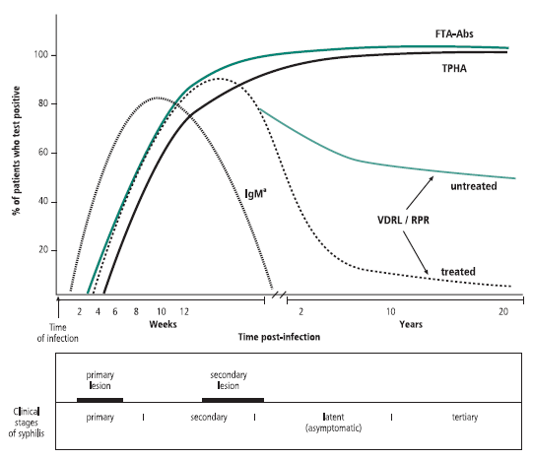
Peeling et al. / Bulletin of the World Health Organization / 2004 / Vol. 82 / No. 6

Slide 26
Impact of HIV Infection on the Diagnostic Tests for Syphilis
Little impact of HIV infection on these diagnostic tests. Use in same manner as in HIV negative pts
Reports of HIV infection and:
  false positive non-treponemal tests (RPR)
  rare reports of delayed or absent seroreactivity
    e.g. - few cases of secondary syphilis with negative RPR and FTA-ABS
  higher mean serological titers
  slower decline in serological titers

Slide 27
Causes of False-Positive Reactions in Serologic Tests for Syphilis
Disease
RPR/VDRL
FTA-ABS
ELISA
Age
Yes
Autoimmune Diseases
Yes
Yes
Yes
Cardiovascular Disease
Yes
Dermatologic Diseases
Yes
Yes
--
Drug Abuse
Yes
Yes
Febrile Illness
Yes
Glucosamine/chondroitin sulfate
Possibly
Hepatitis B S ag, ?Hepatitis C ab
No
No
Yes
Lyme disease
Yes
Yes
Malaria
Yes
No
Pinta, Yaws
Yes
Yes
Yes
Pregnancy*
Yes*
Recent Immunizations
Yes
--
--
STD other than Syphilis
Yes
* May cause increase in titer in women previously successfully treated for syphilis
Adapted from Syphilis Reference Guide, CDC/National Center for Infectious Diseases, 2002

Slide 28
Syphilis EIA/CLIA/MBIA
Advantages:
Automated, may be cost saving for laboratories
May detect old untreated syphilis
Disadvantages:
Less clinical experience with interpretation
Little data about sensitivity/specificity in early disease
Little data about false positive results

Slide 29
Impact of HIV Infection on the Diagnostic Tests for Syphilis
Clinically: little impact of HIV infection on these diagnostic tests
Reports of HIV infection and:
  false positive non-treponemal tests
  rare reports of false negative (delayed or absent seroreactivity)
    e.g - case of secondary syphilis with negative RPR and FTA
  higher mean serologic titers
  slower decline in serologic titers

Slide 30
Syphilis Testing Algorithms
Traditional Syphilis Screening Algorithm
(RPR reflex to FTA-ABS or TPPA)
Newer Syphilis Screening Algorithm
(Specific EIA/CLIA reflex to RPR)

Slide 31
Traditional Syphilis Screening Algorithm
RPR
Nonreactive
Reactive
Specific T. pallidum test
FTA-ABS, TPPA, EIA, CLIA, MBIA
No Syphilis
or
Early primary syphilis
(consider specific T. pallidum
if syphilis suspected)
Nonreactive
Reactive
TPPA or FTA-abs
No Syphilis
? biologic false positive RPR
or
Possible early primary
Consider repeat testing if
syphilis suspected
Syphilis
Evaluate for
treatment

Slide 32
Reverse Syphilis Screening Algorithm using Automated (EIA/CLIA/MBIA ) T. pallidum ab tests
EIA/CLIA/MBIA
Nonreactive
Reactive
No syphilis
or
Early primary syphilis
(consider further testing
if syphilis suspected)
RPR
Nonreactive
Reactive
TPPA or FTA-abs
Syphilis
Evaluate for
treatment
Nonreactive
Reactive
? early primary or late, latent

Slide 33
Interpretation of Automated Specific Syphilis Test Results
Laboratories vary in how results are reported
Review procedures with your laboratory to know what positive, negative, and indeterminate mean
  e.g. Some reflex to confirm EIAs/CLIAs with another specific methodology (e.g. TPPA) and may only report positive if both positive
  e.g. Some laboratories do not reflex to second specific test and may not even automatically reflex to non specific tests (RPR) .

Slide 34
Interpretation of Serologic Test Results for Syphilis
Non-specific test (e.g. RPR,VDRL) | Specific Test (e.g. FTA-ABS, ELISA) | Possible Diagnosis
Reactive | Reactive | Syphilis (old or new) Other treponemal infection (rare in US)
Reactive | Non-reactive | False positive RPR False negative specific test
Non-reactive | Reactive | Treated syphilis Early primary syphilis Very late untreated syphilis Prozone reaction
Non-reactive | Non-reactive | No syphilis Incubating syphilis

Slide 35
EIA Testing in New York
EIA
+
3 laboratories
116,822 specimens
3.1% EIA+ / RPR–
-
6%
n=6,587
94%
What are these?
Old, untreated syphilis
Old, treated syphilis
Early syphilis
False positives
RPR
+
-
44%
n=2884
56%
n=3664
False Positive EIA or False Negative TPPA
TPPA
Managed like prior RPR screening algorithm
n=2512*
+
-
* not all labs reflexed to a second treponemal test
83%
17%
n=2079
n=433
Adapted from Selvam, CDC 2008

Slide 36
TABLE (Adapted): Results of reverse sequence syphilis screening (treponemal test screening followed by nontreponemal test confirmation) --- five laboratories, United States, 2006--2010
Population type | Total no. of specimens | Reactive EIA/CIA treponemal test |  | Nonreactive reflex nontreponemal RPR test |  | Nonreactive TP-PA or FTA-ABS confirmatory treponemal test
 |  | No. of specimens | (% of total) | No. of specimens | (% of reactive treponemal tests) | No. of specimens | (% of nonreactive reflex RPR tests)
Overall | 140,176 | 4,834 | (3.4) | 2,743 | (56.7) | 866 | (31.6)
Low-prevalence population | 127,402 | 2,984 | (2.3) | 1,807 | (60.6) | 737 | (40.8)
High-prevalence population | 12,774 | 1,850 | (14.5) | 936 | (50.6) | 129 | (14.1)
Discordant Results from Reverse Sequence Syphilis Screening --- Five Laboratories, United States, 2006--2010
MMWR February 11, 2011 / 60(05);133-137

Slide 37
TABLE. Results of reverse sequence syphilis screening (treponemal test screening followed by nontreponemal test confirmation) --- five laboratories, United States, 2006--2010
Population type/Laboratory | Treponemal test used | Conjugate type (anti-antibody or antigen) | Total no. of specimens | Reactive EIA/CIA treponemal test |  | Nonreactive reflex nontreponemal RPR test |  | Nonreactive TP-PA or FTA-ABS confirmatory treponemal test
 |  |  |  | No. of specimens | (% of total) | No. of specimens | (% of reactive treponemal tests) | No. of specimens | (% of nonreactive reflex RPR tests)
Overall |  |  | 140,176 | 4,834 | (3.4) | 2,743 | (56.7) | 866 | (31.6)
Low-prevalence population* |  |  | 127,402 | 2,984 | (2.3) | 1,807 | (60.6) | 737 | (40.8)
Southern California† | Trep-Chek | Anti-antibody | 47,952 | 1,278 | (2.7) | 765 | (59.9) | 459§ | (60.0)
Northern California¶ | Liaison | Antigen | 21,623 | 438 | (2.0) | 287 | (65.5) | 88§ | (30.7)
Southern California** | Trep-Sure | Antigen | 57,827 | 1,268 | (2.2) | 755 | (59.5) | 190§ | (25.2)
High-prevalence population†† |  |  | 12,774 | 1,850 | (14.5) | 936 | (50.6) | 129 | (14.1)
New York City§§ | Trep-Chek | Anti-antibody | 7,607 | 1,165 | (15.3) | 639 | (54.8) | 78¶¶ | (12.2)
Chicago*** | Trep-Sure | Antigen | 5,167 | 685 | (13.3) | 297 | (43.4) | 51¶¶ | (18.6)†††
Discordant Results from Reverse Sequence Syphilis Screening --- Five Laboratories, United States, 2006--2010
MMWR February 11, 2011 / 60(05);133-137

Slide 38
Characteristics of Patients with Discrepant Serology
N=288 patients with CLIA+, RPR- serology tested with TPPA
CLIA+, RPR-, TPPA+ patients more likely than TPPA- patients to be:
  Male
  Men who have sex with men
  HIV+
  African-American

Slide 39
Characteristics of Patients with Discrepant Serology
N=288 patients with CLIA+, RPR- serology tested with TP-PA
CLIA+, RPR-, TP-PA+ patients more likely than TP-PA- patients to be:
  Male
  Men who have sex with men
  HIV+
  African-American

Slide 40
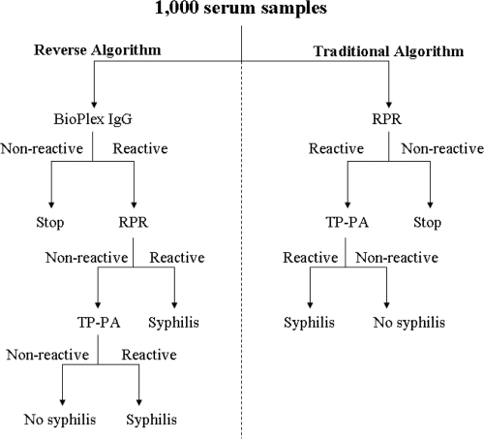
Direct Comparison of Traditional and Reverse Syphilis Screening Algorithms in a Population with a Low Prevalence of Syphilis Binnicker, et al, JCM, 2012
Prospectively collected sera for testing by both algorithms
No duplicate patients
1000 patients tested (sequential)

Slide 41
Results – Traditional Algorithm Results – Reverse Algorithm
Direct Comparison of Traditional and Reverse Syphilis Screening Algorithms in a Population with a Low Prevalence of Syphilis
Binnicker, et al, JCM, 2012
4/1000 + RPR
  4/4 TPPA +
  1/4 – 1:128 neurosyphilis (HIV)
  3/4 – Past treated syphilis
    RPR titers - 1:1
    2/3 with HIV infection
996/1000 - RPR (neg)
15/1000 + Bioplex (1.5% positive)
  9/15 +TPPA
    4/9 +TPPA/+RPR
    5/9 +TPPA and RPR negative
      3/5 past treated syphilis
      2/5 latent syphilis and treated
        Immigration screen and pre-transplant screen
  6/15 TPPA negative/RPR negative
      Presumed false positive Bioplex
      Cognitive disorder (3), urinary incontinence, vaginal discharge, pretransplant exam
985/1000 Bioplex negative

Slide 42
Conclusions:
Direct Comparison of Traditional and Reverse Syphilis Screening Algorithms in a Population with a Low Prevalence of Syphilis
Binnicker, et al, JCM, 2012
Traditional algorithm - no false positives in this study (not always true)
Reverse algorithm resulted in “false positive” rate of .6% but also identified 2 cases of latent syphilis needing treatment
Given rate of false positive EIA – important to do second specific antibody test

Slide 43
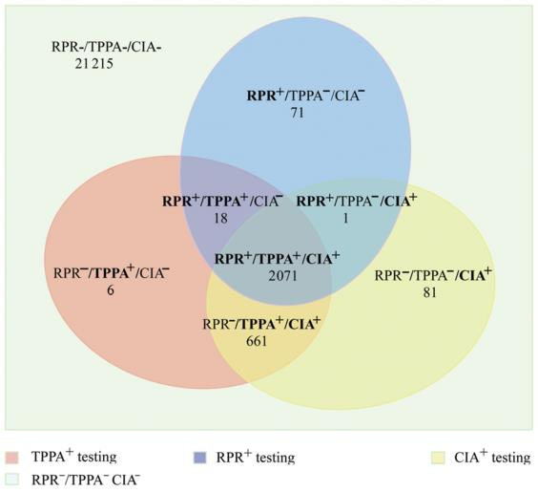

Analysis of 3 Algorithms for Syphilis Serodiagnosis and Implications for Clinical Management
Serologic results.
Tong M et al. Clin Infect Dis. 2014;58:1116-1124
2,071/24,124 positive
on all tests (8.5%)
21,215/24,124 negative on all tests (88%)
2071 RPR + TPPA+CIA+
18 RPR + TPPA +CIA -
71 RPR+TPPA-CIA-
1RPR+TPPA-CIA+
21,215 RPR-TPPA-CIA-
661 RPR-TPPA+CIA+
81 RPR-TPPA-CIA+
6 RPR-TPPA+CIA-
© The Author 2014. Published by Oxford University Press on behalf of the Infectious Diseases Society of America.
Notes:
Serologic results. Boldface font represents positive results. Abbreviations: CIA, chemiluminescence immunoassay; RPR, rapid plasma reagin; TPPA, Treponema pallidum particle agglutination.

Slide 44
Impact of switching to Reverse Algorithm
Initially causes headaches! More time consuming for public health workers. Lots of questions regarding test performance/test interpretation
Absolute number of “false positives” may not be very different (71 vs 81 in prior slide) but now identify additional old true cases as well (an additional 661 in prior slide)
  Higher rates of concordant results in high prevalence areas
    (high prevalence may reflect prevalence from years in past)
  Even in low prevalence settings - more staff time to investigate discordant results and assess need for treatment
  Even in low prevalence settings – will pick up some late, latent cases who need treatment

Slide 45
Most Frequent Question: What to do with Discordant Reverse Syphilis Screening Algorithm Tests?
Reactive
Nonreactive
EIA/CLIA
No syphilis
or
Incubating or
Early primary syphilis
(consider further testing
if syphilis suspected)
RPR
Nonreactive
Reactive
TPPA or FTA-abs
Syphilis
Evaluate for
treatment
Nonreactive
Reactive
? early primary or late, latent

Slide 46
What to do? EIA/CIA/MBIA +/RPR -
CDC recommendations: Obtain second specific T. pallidum ab test (ideally directed against different T. pallidum antigens than first test
    Prefer TPPA over FTA-ABS
1) If second test also +, evaluate for active syphilis in usual manner:
a) Assess for signs/symptoms of Syphilis; If present, treat appropriately
    With negative RPR, this would likely be early primary, prozone phenomenon, or very late syphilis (tabes dorsalis)
b) Assess for history of prior syphilis?
    Likely need syphilis registry at DOH at county of residence at time of diagnosis. Syphilis serologies are saved through DOH throughout NY.
    If yes and treated appropriately in past- no further action
    If untreated, or improperly treated prior syphilis – treat as late, latent syphilis
2) If second test negative:
    and low risk for active syphilis, no further action
    and high risk, retest in 2-4 weeks to evaluate for early syphilis

Slide 47
Response to Therapy by Syphilis Stage:
The Details – must use quantitative tests (RPR)
“Treatment failure can occur with any regimen. However, assessing response to treatment frequently is difficult, and definitive criteria for cure or failure have not been established.” CDC STD Treatment Guidelines, 2010
  RPRs may decline more slowly for persons who previously have had syphilis
Those with persistent or recurrent signs/symptoms or who have a sustained fourfold increase in RPR “probably failed treatment or were re-infected.”
  Retreat and reevaluate for HIV infection and LP

Slide 48
SEROLOGIC TITERS OF RPR/VDRL
1 : 1024
1 : 512
1 : 256
1 : 128
1 : 64
1 : 32
1 : 16
1 : 8
1 : 4
1 : 2
1 : 1

Slide 49
Response to Therapy by Syphilis Stage:
The Details (Primary and Secondary)
Clinical and serologic follow-up at 6 and 12 months recommended
Recurrence of signs/symptoms or four fold rise in RPR titer suggest reinfection or treatment failure
  LP should be strongly considered (difficult to tell failure vs new infection)
  HIV testing recommended
  Retreat – length of therapy dependent on LP results
Failure of RPR titers to decline fourfold within 6–12 months might indicate treatment failure
  Literature shows >15% of treated patients with early syphilis will not achieve the two dilution decline in RPR by 1 yr. Optimal management of such patients not clear:
    “At a minimum” - Reevaluate for HIV and follow-up beyond 1 year
    If additional f/u cannot be ensured, retreatment recommended
    Consider LP
    Retreatment - IM Benzathine PCN weekly x 3 (unless CSF is +)
Rarely, serologic titers do not decline despite a negative CSF examination and a repeated course of therapy.
  Need for additional therapy and/or repeated CSF examinations is unclear, but is not generally recommended

Slide 50
Response to Therapy by Syphilis Stage:
The Details – Latent Syphilis
Quantitative serologic tests (RPRs) repeated at 6, 12, and 24 months
A CSF examination should be performed if:
  1) titers increase fourfold or
  2) an initially high titer (≥1:32) fails to decline at least fourfold (two dilutions) within 12–24 months of therapy, or
  3) signs or symptoms attributable to syphilis develop.
If the CSF examination is negative, retreat as late, latent (3 shots)
In rare instances, serologic titers do not decline despite a negative CSF examination and a repeated course of therapy.
  In these circumstances, the need for additional therapy or repeated CSF examinations is unclear.

Slide 51
Response to Therapy by Syphilis Stage:
The Details – HIV Co-Infection
Primary and Secondary Syphilis: Clinical and Serologic follow up (RPR) at 3, 6, 9, 12, and 24 months after therapy.
Latent Syphilis: Clinical and Serologic follow up (RPR) at 6, 12, 18 and 24 months after therapy.
Those with signs/symptoms that persist or recur or persons who have a sustained fourfold RPR rise should have a CSF examination and retreatment. (just like HIV neg)
  CSF examination and retreatment also should be strongly considered for persons whose RPR does not decrease fourfold within:
    6–12 months of therapy for primary and secondary syphilis cases
    12-24 months for latent syphilis cases .
  If CSF examination is normal, treat as late, latent (3 shots).

Slide 52
When to do an LP?
Everyone agrees LP needed with:
  Neurologic signs and symptoms (including eye/ear complaints)
  Other evidence of tertiary syphilis (gummas)
  Treatment Failure – recurrent signs/symptoms, fourfold rise in RPR titer

Slide 53
When to do an LP?
Some authorities recommend LP if:
  failure of RPR titers to decline 4 fold in recommended time frames (6-12 months for primary/secondary or 12-24 months for latent syphilis and HIV infection)
  all latent syphilis with high titers (>1:32)
  all HIV infected patients with syphilis
  usual plus HIV infected with high titers
  LP before and after treatment in HIV infected pts
  LP 6 months after treatment in HIV infected pts

Slide 54
Interpretation of CSF results
Definite diagnosis: Positive CSF syphilis test or identification of organism
Presumptive diagnosis: abnormal LP and syphilis
  lymphocytic pleocytosis, and/or increased protein
  major problem: HIV infection associated with similar CSF abnormalities
Must treat HIV infected patients with syphilis and CSF abnormalities for neurosyphilis

Slide 55
Case:
25 yo pregnant female (HIV neg). Pt with history of anaphylaxis to PCN.
2/24 - EIA R, RPR NR, TPPA neg
  No treatment – presumed false + EIA
9/5 – EIA equivocal, RPR NR, TPPA neg
  No treatment, presumed false + EIA
9/23 – EIA R, RPR NR, TPPA positive
  Admitted for desensitization to PCN - Ultimately not done after review with DOH
10/17 – RPR NR
Had normal delivery, healthy infant

Slide 56
Case
37 yo MSM, HIV neg, history genital herpes, presents with self reported h/o genital ulcer- now resolved and new rash on exam
  EIA R, RPR 1: 4096
  Treated with Benzathine PCN for secondary syphilis. Advised to repeat exam/titer/HIV test in 3 months due to high risk
  Two months later: Returns with new GUD typical of HSV, and reported re-exposure to secondary syphilis
    Repeat HIV negative (ag/ab)
    Darkfield negative, DFA ulcer negative
    HSV culture is pending
    EIA +, RPR 1:256

Slide 57
Case:
34 yo HIV, no meds, CD4 200, rash and history of sex for money/drugs
EIA R, RPR 1:512 – Treated for secondary syphilis
Two weeks later, red eye, photophobia
  LP CSF VDRL – negative
  Cell count 54 cells, primarly lymphs
  TP 112, glucose 65
  Treated with IV PCN for 14 days for presumed neurosyphilis with iritis
  Linked to care for HIV – now undetectable
  FU LP reverted to normal at 24 months
  RPR declined to 1:2 over 36 months

Slide 58
Questions?
Please send questions via email to: STD@CEITRAINING.ORG
AND NOW AVAILABLE:
STD CLINICAL CONSULTATION CALLS:
866-637-2342

