Slide 1
Syphilis 2015 An Update & Review of Epidemiological Trends, and Issues in Diagnostic Evaluation and Management
Thomas Cherneskie, MD, MPH
Supervising Physician, Chelsea-Riverside STD Clinic
NYC Department of Health & Mental Hygiene
Faculty member of CDC-funded NYC STD/HIV Prevention Training Center

Slide 2
Acknowledgements & Disclaimers
Disclaimer:
No personal financial relationship with the manufacturer of any products or services mentioned during todays presentation
Thanks to:
Alison Muse, Director of Bureau of STD Prevention & Epidemiology, NYS DOH
Preeti Pathela, Bureau of STD Control & Prevention, NYC DOHMH
Dr. Miguel Sanchez and NYU Department of Dermatology

Slide 3
Syphilis 2015: Session Objectives
Identify the causative organism & clinical course
Incubating infection
Stage “progression”
Explain the current epidemiology of syphilis in NYS
Who is most at risk, in NYS, 2015?
Describe the diagnostic criteria for each stage of syphilis
Dermatologic exam findings
Interpretation of serologic testing results
Staging asymptomatic infections
Limitations of testing in ruling out suspected infection

Slide 4
Syphilis 2015: Session Objectives (continued)
List the current recommended stage-specific treatments
First-line treatment recommendations
Alternate treatment options
Special patient populations/circumstances
Penicillin allergy
HIV co-infection
Pregnancy
Post-treatment follow-up
Outline approaches to partner management
Access state & local health department resources

Slide 5
Reported Primary and Secondary (P&S) Syphilis
New York City, 1940-2013
Year
Notes:
Since 1960, 7-10 year cycle
1998- NYC (and the country) on the verge of syphilis elimination
Blow up last 15 years on next slide

Slide 6
Case rate (per 100,000 population) of Reported Primary and Secondary Syphilis New York State and New York City, 1999-2014
Case Rate per 100,000 population
Notes:
As we can see in this slide, the recent increase in case rate has been driven by increases among males.
Males make up 96% of P&S syphilis cases in NYC. The female case rate has remained steady over the past several years, at 0.5 cases per 100,000 females.
Interview data- majority of cases in MSM
70-75% of interviewed P&S report being MSM

Slide 7
Age Adjusted Rate of Primary and Secondary Syphilis by Gender and Year, NYS excluding NYC, 1999-2014
Case Rate per 100,000 population
Year of Report

Slide 8
Case rate (per 100,000 population) of Primary & Secondary Syphilis Diagnoses reported to the NYC DOHMH, 1996-2014, by sex
Case Rate per 100,000 population
Notes:
As we can see in this slide, the recent increase in case rate has been driven by increases among males.
Males make up 96% of P&S syphilis cases in NYC. The female case rate has remained steady over the past several years, at 0.5 cases per 100,000 females.
Interview data- majority of cases in MSM
70-75% of interviewed P&S report being MSM

Slide 9
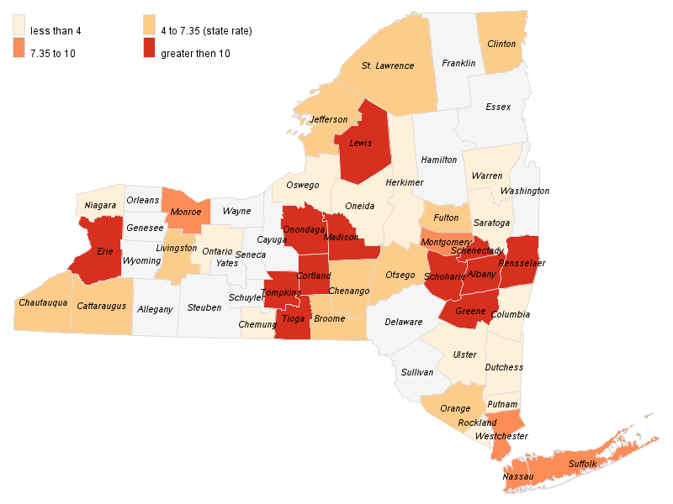
Rate per 100,000 men
Age-Adjusted Primary and Secondary Syphilis Rates among Males by County, NYS
Excluding NYC, 2014

Slide 10
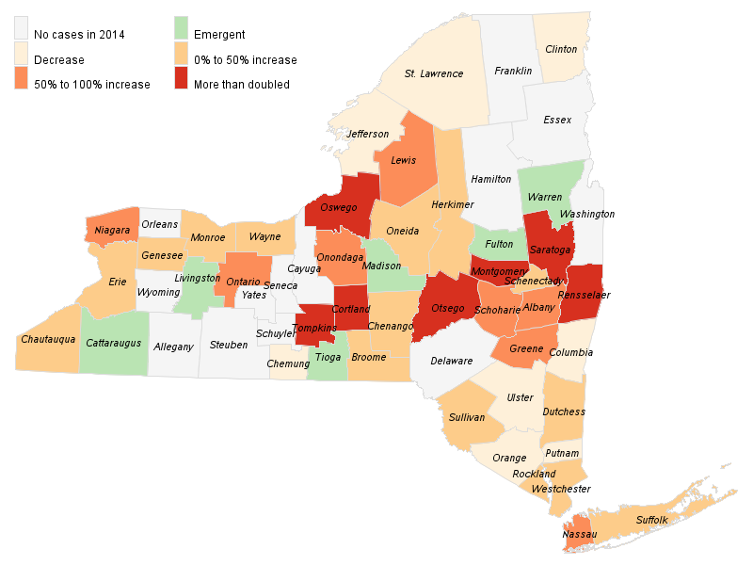
Percent Change
Increases in Number of Early Syphilis Cases by County, NYS
Excluding NYC, 2014

Slide 11
Self-reported HIV status among interviewed MSM primary & secondary syphilis cases, NYC, 2000-2014
N=12
65
141
148
208
216
188
350
519
735
539
433
443
607
814
Data based on cases reported to the NYC DOHMH.
Interviewed cases only
Excludes cases with self-report of unknown HIV status
Notes:
Up to 15-20% unknown status→ so % co-infection is likely underestimated
Possible explanations for increased burden of new syphilis infections among HIV+ MSM:
Increased susceptibility due to HIV? Less of an issue with greater proportion of pts in care and virally suppressed
Diminishing effect of anxiety of HIV acquisition/transmission on condom use: Serosorting by HIV+ men; Undetectable VLs, ?PreP (though not evident in PreP studies)
Generational issues: generational absence of AIDS images among younger gens; condom/prevention fatigue

Slide 12
Source of Provider Report, Primary and Secondary Syphilis by Race and Year among Males, NYS excl NYC, 2010-2014
Hospital
32%
STD Clinic
Private MD
Overall
White
Non-Hispanic
Black
Non-Hispanic
Latino

Slide 13
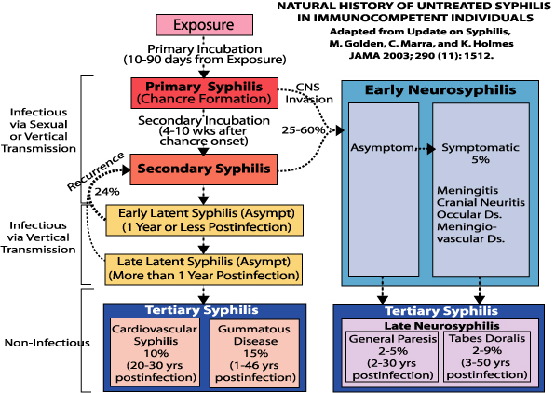
Notes:
Incubation Periods: Primary 2-6 weeks (9-90 days); Secondary 4-10 weeks (

Slide 14
Stages of Syphilis
Primary- Muco-cutaneous ulceration
Secondary
Diffuse or Localized Cutaneous Eruption
Mucous Patches
Condyloma Lata
Patchy Alopecia
Tertiary- Cardiovascular & Gummatous
Neurosyphilis-
Early (CN dysfxn, stroke, ocular)
Late (tabes dorsalis, general paresis)
Asymptomatic
Latent- Asymptomatic at time of treatment
Early Latent
Late Latent
Latent of unknown duration
Symptomatic
Asymptomatic

Slide 15
Relevance of Accurate Syphilis Staging
 | PRIMARY | SECONDARY | LATENT
 |  |  | EARLY | UNKNOWN | LATE
Currently Infectious ? | YES |  |  | Possibly | No
Duration of Therapy | Bicillin IM x1 Doxy PO x 2 weeks |  |  | Bicillin IM x3 Doxy PO x4 weeks
Management of Sexual Contacts | Previous 3 months | Previous 6 months | Previous 12 months |  | ?
Serologic Response to Treatment | RPR titer: 2 dilution fall in 6 -12 months |  | If RPR >/= 1:32: 2 dilution fall in 12 - 24 months
Notes:
Recurrent secondary symptoms up to 5 yrs post-infection (but mostly within 12 mo).
Per CDC Guidelines (2015): “Sexual transmission of T. pallidum is thought to occur only when mucocutaneous syphilitic lesions are present. Such manifestations are uncommon after the first year of infection.”
Per BASHH (2008): Definition of Early Latent (ie. Infectiousness) = Infected within preceding 2 yrs
Vertical transmission: “Although vertical transmission may occur at any time within 10 years of initial infection, this becomes unusual more than two years after the onset of early syphilis”

Slide 16
Genital Ulcer Disease The Usual Suspects
Genital Herpes- Herpes Simplex Virus types 1 & 2
Primary Syphilis- Treponema pallidum
Chancroid - Haemophilus ducreyi
Lymphogranuloma Venereum (LGV)- C. trachomatis
[Granuloma venereum/Donovanosis- Klebsiella granulomatis]
Candidiasis/Balanitis
Aphthosis major
Behcet’s disease
Fixed Drug Eruption
Stevens-Johnson Syndrome
Lichen Planus (Erosive)
Erythema Multiforme Reiter’s Syndrome
Trauma
Cancer- Squamous Cell
Notes:
US Chancroid Cases: 2009 (28); 2010 (24); 2011 (8); 2012 (15); 2013 (10)

Slide 17
Diagnostic & Screening Tests for Syphilis
Sensitivity | Specificity
Primary 86% Secondary 100% Late Latent 73% | 98%
Primary 86% Secondary 100% Late Latent 96% | 97%
Non-Treponemal
RPR
VDRL
Treponeme-specific
FTA-ABS
TPPA
IgG EIA
Lesion-based Testing
Darkfield
PCR: Not FDA approved though may be available through individually-validated local labs
Notes:
Although both Non-Trep and Trep-specific tests have a fairly high sensitivity, their one area of weakness if detecting early primary infections.
Therefore must rely upon: 1. Index of suspicion and presumptive Rx; 2. Lesion based testing; or 3. repeat testing in 2 weeks to identify seroconversion.

Slide 18
Stages of Syphilis
Primary
Muco-cutaneous ulceration
Secondary
Diffuse or Localized Cutaneous Eruption
Mucous Patches
Condyloma Lata
Patchy Alopecia
Latent- Asymptomatic at time of treatment
Early Latent
Late Latent
Latent of unknown duration
Neurosyphilis
Tertiary- Cardiovascular & Gummatous

Slide 19
Differential Diagnosis of Secondary Syphilis
Pityriasis Rosea
Drug eruption
Viral exanthem
Acute HIV
Sarcoidosis (annular lesions)

Slide 20
Latent (Asymptomatic) Syphilis
Interpretation of syphilis serology results
Differentiation of 3 latent syphilis stages
Early Latent (acquired < 12mo ago)
Late Latent (acquired > 12mo ago)
Latent of unknown duration (acquired ?)
Detection of asymptomatic infections through appropriate screening

Slide 21
 | NON-TREPONEMAL (e.g. RPR, VDRL) | TREPONEME-SPECIFIC (e.g. FTA-ABS, TPPA, EIA)
1. Serum Ab Detected | Antibody to cardiolipin-cholesterol-lecithin antigen | Antibody to recombinant treponemal antigen
2. Type of result | Provides both qualitative (reactive vs. non-reactive) and qualitative (titer) results | Qualitative result only
3. Test difficulty & cost | Performed manually with visual interpretation; → more labor/time intensive | Can be automated; → cost saving for large volume laboratories
4. Specificity | Imperfect specificity
 | Biologic False Positive Lower specificity, therefore must be confirmed by a treponeme-specific test | Cross-reacting serum antibodies Greater specificity therefore traditionally used to confirm a pos. non-treponemal result
Notes:
BFP in general pop: 0.3 - 1%

Slide 22
 | NON-TREPONEMAL | TREPONEME-SPECIFIC
5. Association with disease activity | YES Titers decline following Rx and rises with reinfection Often reverts to non-reactive after successful Rx May revert back to non-reactive even without treatment after prolonged latency | NO Can't distinguish current active (unRxed) from past inactive (previously Rx'ed/cured) infection Generally long-lasting reactivity despite curative Rx May be able to detect old untreated infection (where RPR lost its reactivity due to low disease activity)
6. Clinical uses | Screening patient with no past history of syphilis
 | Measure post-Rx response Detect ASx re-infection in pts w/ past Hx of Rx | Confirm a pos. non-treponemal result May be able to detect old untreated infection
Notes:
seroreversal RPR- where RPR lost its reactivity due to low disease activity

Slide 23
Serologic Interpretation
RPR Non-Reactive /
FTA-ABS Non-Reactive
No Syphilis Diagnosis
Incubating syphilis infection
Very Early Primary Syphilis
RPR Reactive /
FTA-ABS Non-Reactive
Biologic False Positive
False-negative Treponemal Test (rare)
RPR Non-Reactive/
FTA-ABS Reactive
Very Early Primary Syphilis
Secondary Syphilis w/ Prozone (1-2%)
Late untreated syphilis w/ sero-reversal of RPR
History of Treated Syphilis
Syphilis Rxed inadvertently in past
False-negative Non-Treponemal test
False-positive Treponemal Test (rare)
RPR Reactive /
FTA-ABS Reactive
Positive Syphilis Diagnosis
Lyme disease
Endemic (non-sexual) treponemal ds

Slide 24
BIOLOGIC FALSE POSITIVE REACTION
ACUTE (< 6 months)
CHRONIC > 6 months
Physiologic
Pregnancy
Vaccinations
Smallpox
Typhoid
Yellow fever
Acute Infections
Herpes varicella-zoster
Herpes simplex
Infectious mononucleosis
Measles
Mumps
Viral hepatitis
HIV sero-conversion illness
Pneumonia (incl. Mycoplasma)
Lyme disease
Physiologic
Older age
Chronic Infection
Tuberculosis
Malaria
HIV/AIDS
Autoimmune Disorders
Lupus
Rheumatoid arthritis
Autoimmune thyroiditis
Other Conditions
Malnutrition
Malignancy
Hepatic cirrhosis
Intravenous drug use
Notes:
BFP reactions with RPR tend to be “low” titer, therefore the higher the titer (e.g. 1:16, 1:32) the more important it is to r/o false negative Treponemal test (repeat testing, use of alternate trep-specific test).

Slide 25
Serologic Interpretation
RPR Non-Reactive /
FTA-ABS Non-Reactive
No Syphilis Diagnosis
Incubating syphilis infection
Very Early Primary Syphilis
RPR Reactive /
FTA-ABS Non-Reactive
Biologic False Positive
False-negative Treponemal Test (rare)
Screening IgG Reactive
With RPR NonReactive
RPR Non-Reactive/
FTA-ABS Reactive
Very Early Primary Syphilis
Secondary Syphilis w/ Prozone (1-2%)
Late untreated syphilis w/ sero-reversal of RPR
History of Treated Syphilis
Syphilis Rxed inadvertently in past
False-negative Non-Treponemal test
False-positive Treponemal Test (rare)
RPR Reactive /
FTA-ABS Reactive
Positive Syphilis Diagnosis
Lyme disease
Endemic (non-sexual) treponemal ds

Slide 26
Reverse Sequence Serologic Screening for Syphilis
Screening EIA
or other
Treponeme-Specific Test *
NON-REACTIVE
No Syphilis Infect.
Ulcer on exam
- presumptive Rx
- lesion-based test
- repeat serology 2wks
Recent expos. to case - presumptive Rx
Rule Out:
Early primary
Incubating Infect.
REACTIVE
RPR
REACTIVE
EIA (+); RPR Reactive
Confirmed Syphilis Infection
Current, active, untreated Infection
Old treated (r/o re-infection: ? titer rise)
NON-REACTIVE
Second
Treponeme-specific Test
(FTA-ABS, TP-PA, TP Ab)
REACTIVE
EIA (+); RPR Reactive; TP-PA Reactive
Confirmed Syphilis Infection
Very Early Primary (i.e. sero-conversion)
Untreated/ Inadequately Treated
Late Latent w/ RPR sero-reversal
Partial Rx (after Rx for non-syphilic infection)
NON-REACTIVE
Syphilis Unlikely
i.e. False (+) EIA/CIA
* EIA: Enzyme immunoassay
CIA: Chemiluminescence immunoassay
MFI: Multiplex flow immunoassay
FTA-ABS: Fluorescent Treponemal Ab, absorption
TP-PA: Treponema pallidum particle agglutination
Rule Out:
Early primary
Incubating Infection
Notes:
EIA- high specificity
PPV depends on population prevalence: Low prevalence pop. 40% EIA-pos/RPR-neg are False+s

Slide 27
Past history of syphilis treatment
Stage & Treat
REACTIVE
Non-Treponemal (RPR/VDRL)
SYPHILIS INFECTION:
? PAST or PRESENT ?
NO
YES
Reliable/documented treatment
NO
Trep-specific
(FTA-ABS, TP-PA)
YES
REACTIVE
Treatment adequate for syphilis stage
NO
NON-REACTIVE
YES
Biologic False Positive
NO
Adequate post-treatment serologic response
YES
Evaluation of inadequate response to Rx
RPR 2-Titer Rise from Post-Rx “Baseline”
YES
NO
Re-infection unlikely; Screen PRN
NO
Recent known syphilis exposure; or
Exam findings suspicious for P/S
YES
? Presumptive Rx
Lesion-based Test
Repeat Titer

Slide 28
Rapid Point-of-Care Syphilis Testing
Immuno-chromatographic treponeme-specific tests
Whole blood or finger stick specimen; results ~10 minutes
Cannot provide quantitative result (i.e. titer) or distinguish past treated vs. active untreated infections
Combination/Dual tests on the horizon
2 different Abs to same infection (eg. NT Ab + TS Ab)
Abs to 2 different infections (e.g. Syphilis + HIV)
Syphilis Health CheckTM
2011: FDA approval for use in U.S
Dec. 2014: FDA grants CLIA waiver; dropped from moderate/high complexity classification

Slide 29
Reactive Syphilis Serology
Syphilis Staging
Primary (ulceration)
Confirm with DF or PCR if in doubt
Stage-specific Rx
Clinical exam findings consistent w/ syphilis
YES
Dermatologic signs of Secondary
Exam evidence of Tertiary or
Neuro Syphilis
CSF Exam
Rx based on further evaluation
NO
Past history of
syphilis treatment
YES
2 dilution
RPR titer rise
YES
Treat for Early Latent Syphilis
NO
within past 12 months
NO
Non-Reactive RPR (Sero-conversion)
YES
Unequivocal Sx of primary/ secondary
YES
Within past
12 months
YES
Exposure to confirmed infectious case
YES
1st started having sex
NO
Treat for Late Latent Syphilis *
* or Latent Syphilis of Unknown Duration

Slide 30
Increasing Diagnosis & Case Detection
Maintain high index of suspicion in patients presenting with ano-genital ulcers or other dermatologic findings, esp. if increased risk
Be cognizant of limitations in test sensitivity and possibility of false negative results
Identify asymptomatic infections via appropriate levels of screening
Utilize brief sexual history to identify pts at risk
Perform serologic screening when indicated

Slide 31
Syphilis Cases, by Stage and Gender, NYC, 2014
N=1905
74% ASx
N=516
94% ASx
N=1822
N=1272
N=126
Primary & Secondary
Early Latent
Late Latent/ Latent Unk. Duration
Notes:
Syphilis, at diagnosis, is largely an asymptomatic infection, underscoring the importance of routine screening among at risk patient populations, routine prenatal screening, and timely evaluation and screening of exposed partners.
NYS: similar proportions though among males 37% cases are P&S (vs. ~25% in NYC)→ ? Need for greater use of ASx screening outside of NYC (?issue of patients not recognized as MSM and therefore missed opportunities for screening)

Slide 32
Syphilis Screening: USPSTF
Persons at increased risk for syphilis infection
MSM with high-risk sexual behavior
Commercial sex workers & persons who exchange sex for drugs
Adults in correctional facilities
? Persons diagnosed with another STI
All pregnant women

Slide 33
CDC Screening Recommendations: http://www.cdc.gov/std/tg2015/screening-recommendations
Sexually active MSM
At least annually
Every 3-6 mo. if increased risk
Sexually active persons with HIV
At initial HIV evaluation
At least annually
More frequently depending on individual risk behaviors (e.g. q4months per AIDS Institute, 2014)
Pregnant women
At 1st prenatal visit
Early in 3rd trimester & at delivery if at high risk
Multiple partners
Anonymous partners
Illicit drug use
(esp. crystal meth)
NYC DOHMH, 2014
Notes:
HSV
Also Hep B screening in MSM

Slide 34
Syphilis– Treatment Issues
STAGE | First Line Drug of Choice | Alternative
Primary Secondary Early Latent | Benzathine PCN 2.4mU IM x1 | Doxycyline 100mg BID x 14 days
Late Latent Latent of Unknown Duration | Benzathine PCN 2.4mU IM weekly x 3 weeks | Doxycyline 100mg BID x 28 days
Must ensure use of Bicillin LA (not C-R)
Azithromycin (2g oral) not recommended
Caution- Any non-PCN regimen in HIV+
Pregnancy: PCN is the only acceptable regimen
Based on 2015 CDC Treatment Guidelines

Slide 35
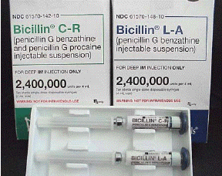
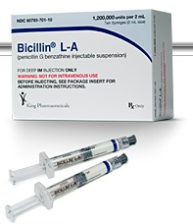
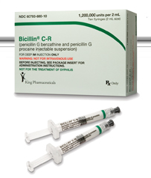
2004
Packaging
Current Packaging
Notes:
Bicillin CR: Benzathine + Procaine

Slide 36
Syphilis Treatment Options- Effectiveness
 | Benzathine PCN | Doxycycline | Ceftriaxone | Azithromycin 2g
EARLY SYPHILIS PRIMARY SECONDARY EARLY LATENT | ✔ | Limited studies | Comparable to Bicillin in several small studies, but daily IM/IV dosing x 10-14 days | Effective but not 1st Line due to emergence of resistance
LATE LATENT | ✔ |  | Not well studied | Not recommended
PREGNANT WOMAN | ✔ | Contra-indicated | Not well studied | Not recommended
HIV-INFECTED | ✔ | ? Not well studied; need close follow-up; desensitize if risk of non-compliance |  | Not recommended
✔ Strong clinical trials, observational studies, and decades of clinical experience

Slide 37
CDC Guidance re: Delayed Bicillin Doses
Clinical experience suggests that an interval of 10–14 days between doses…might be acceptable before restarting
Pharmacologic considerations suggest that an interval of 7 to 9 days between doses, if feasible, may be more optimal
Missed doses are not acceptable for pregnant patients being treated for latent syphilis
2015 CDC STD Treatment Guidelines

Slide 38
Jarisch-Herxheimer Reaction
Immune-mediated reaction; treponemal endotoxins
2-24 hours following initiation of treatment
Fever, headache, myalgias
50-75% primary/secondary cases
↑ with higher titers
↓ with history of previous treatment
Management: antipyretics, NSAIDs
Pregancy
Preterm labor, uterine contrations, fetal distress
Need for close monitoring but not delay in Rx

Slide 39
2 yrs ← 9 mo ago
5 mo ago
3 mo ago thru present
Matthew
Jason
Brian
Maximum Range for Infectious Period
Rash
Patient
Treated
6 months
Symptom Onset
Management of Sexual Contacts/Partners
Which option is most appropriate for each partner noted above?
a. No significant risk of exposure- Forgo any testing/Rx
b. Perform screening (by exam and serology)
→ If Positive, provide treatment
c. Presumptive treatment, even in face of negative testing
Notes:
1983 Br J Vener Dis article on infectiousness: Of contactable sexual partners of patients with early syphilis, 46–60% also have the infection.

Slide 40
Syphilis: Defining the Communicable Period
????
LATE LATENT
EARLY LATENT
SECONDARY
PRIMARY
12
6
3
0
Months prior to symptom onset (or diagnosis date if asympt.)

Slide 41
www.inspot.org

Slide 42
Response to Therapy by Syphilis Stage
Stage | Repeat RPR Titers
 | HIV-negative | HIV-positive
Primary, Secondary | 6 months 12 months | Every 3 months x 1 year Recheck at 24 months
Early Latent, Late Latent | 6 months 12 months 24 months | Every 6 months x 2 years
Primary, Secondary Syphilis
- Resolution of symptoms
- By 6-12 months: Fall in RPR by 2 titers
Early Latent, Late Latent Syphilis
- If RPR titer >/= 1:32
Fall in RPR by 2 titers within 12-24 months
Pts w/ HIV: Rare occurrences of unusual post-treatment serologic responses (e.g. fluctuating or high serofast serologic titers)
Notes:
Clinical trial data: >15-27% of patients w/ treated early syphilis will not achieve the two dilution decline at 1 year. Pts should be reevaluated for HIV infection. Optimal management unclear.
HIV+: Conflicting data re: delayed serologic response to Rx

Slide 43
Approach to Inadequate Serologic Response to Treatment
Evaluate for possible re-infection
Re-screen for HIV
Consider suboptimal treatment
Inaccurate staging of infection
Non-compliance with oral therapy
Rule out Neurosyphilis (CSF exam)
Re-treat with Bicillin 2.4 mU IM x 3

Slide 44
Indications for CSF Exam
Neurologic or Ophthalmic Signs/Symptoms
Evidence of Active Tertiary (aortitis, gumma)
Inadequate Serologic Response to Treatment
HIV+ with Late Latent or Latent Unknown Dur.
HIV+ patients
RPR >/= 1:32
CD4 </= 350
Although associated with clinical and CSF abnormalities consistent with neurosyphilis- if asymptomatic, no data that CSF exam in these patients improves clinical outcomes
??
CSF
Exam
Based on 2015 CDC Treatment Guidelines

Slide 45
Neurologic or Ophthalmic Signs/Symptoms of Syphilis
Headache, vertigo, neck stiffness without fever, seizures, focal symptoms
Cognitive dysfunction, mental status or personality changes, dementia, psychosis
Cranial nerve dysfunction (esp. facial/auditory)
Ophtho (optic neuritis, iritis, pupillary dysfxn)
Peripheral neuropathies (lightning pain, sensory/motor or reflex deficiencies, gait disturbance)

Slide 46
CDC Advisory: Identification & Management of Ocular Syphilis
All syphilis cases:
Screen for visual/ocular symptoms
Perform neuro exam including cranial nerves
Syphilis cases with ocular symptoms:
Ophthalmologic eval ASAP
CSF Examination
Treatment for 10-14 days
Aqueous crystalline penicillin G IV or
Procaine penicillin IM with Probenecid
Report case to local/State DOH within 24hrs

Slide 47
Ocular Syphilis: Common Symptoms
Blurred/ decreased vision
New onset floaters
Redness of the eye
Eye pain
Photophobia
Altered color perception (washed out colors)
Scotomas
Tearing
Blepharospasm (twitching of lid)
Pain with eye movement
Posterior Uveitis & Panuveitis

Slide 48
CDC Advisory: Identification & Management of Ocular Syphilis
All syphilis cases:
Screen for visual/ocular symptoms
Perform neuro exam including cranial nerves
Syphilis cases with ocular symptoms:
Ophthalmologic eval ASAP
CSF Examination
Treatment for 10-14 days
Aqueous crystalline penicillin G IV or
Procaine penicillin IM with Probenecid
Report case to local/State DOH within 24hrs

Slide 49
www.cdc.gov/std/tg2015
or search “CDC STD Treatment”

Slide 50
STD Clinical Resources in New York State
NEW YORK STATE
Clinical Consultation CEI STD Center for Excellence | 1-866-637-2342
Guidance on STD case Reporting | http://www.health.ny.gov/professionals/diseases/reporting/communicable/
NEW YORK CITY
Clinical consultations or referrals for Dark Field testing | 347-396-7274
Syphilis Treatment & Serologic Titer Registry | 347-396-7201
Alternate contact numbers | 347-396-7200 1-866-NYC-DOH-1
Case Reporting- Directions for Provider Reporting | http://www.nyc.gov/html/doh/html/hcp/hcp-reporting.shtml

